Slide 1


VerifiEd — Global AI Scam Detection Platform

Slide 2


Contents
01
Problem & Impact
02
Solution & Features
03
Reach & Conclusion

Slide 3

01
Problem & Impact

Slide 4


The Problem: A 300% Surge
Scams targeting students have increased dramatically, making them prime targets due to their active search for opportunities.
Financial Loss: Direct theft and fraudulent fees.
Wasted Time: Missed genuine opportunities.
Identity Theft: Personal data compromise.

Slide 5
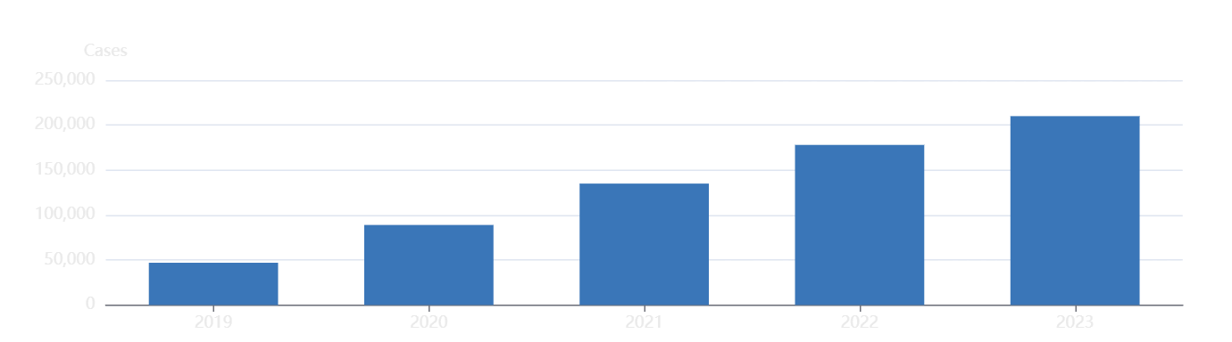
Global Scam Cases Accelerate
The number of reported scam cases has shown a dramatic and consistent increase over the past five years, highlighting a growing global threat.

Slide 6
The Real Damage Extends Beyond Money
Financial Loss
Personal Data Exposure
Direct monetary theft and fraudulent fees.
Sensitive information is harvested and sold.
Fake Certificates
Identity Theft
Worthless documents that can harm reputations.
Long-term damage to credit and personal life.

Slide 7
02
Solution & Features

Slide 8
VerifiEd
Global AI Scam Detection Platform
Protecting Students & Adults from Online Scams with AI-Powered Verification.
Students
Job Seekers
Everyone

Slide 9
Why Current Defenses Are Failing
No Universal Verification
Unregulated Ads
A fragmented landscape allows scams to slip through the cracks.
Deceptive Realism
Social media platforms are a breeding ground for unvetted scams.
Fake websites are expertly designed to mimic legitimate ones.

Slide 10

Meet VerifiEd
AI-Powered Authentication Engine
VerifiEd uses advanced AI to detect scam patterns across internships, scholarships, and job postings, providing a transparent Scam Probability Score to guide safer decisions.
Instantly identify suspicious elements.

Slide 11
Four-Step Instant Scam Check
1. Upload
2. AI Analysis
3. Cross-Check
4. Score & Explain
Link or Screenshot
Pattern Recognition
Global Database
Scam Probability

Slide 12
Five Core Features for Total Safety
Fake Internship Detector
Fraud Email Analyzer
Organization Verification
Global Scam Database
Instant Alerts & One-Click Reporting

Slide 13
03
Reach & Conclusion

Slide 14
Students
Parents
Universal Protection
For Users Worldwide
VerifiEd is an inclusive tool designed for anyone who encounters opportunities online, regardless of location or background.
Job Seekers
Professionals
Educational Institutions

Slide 15
Measurable Impact on Digital Safety
Reduces Victims
Saves Money
Increases Safety
Builds Trust
Significantly decreases the number of scam victims globally.
Protects collective user funds from fraudulent schemes.
Heightens overall digital safety awareness among users.
Restores confidence in legitimate online opportunities.

Slide 16
Verify Before You Trust
In a world full of digital scams, proactive verification is essential. VerifiEd empowers everyone to make safer decisions.
Stay Safe. Stay Verified.

Slide 17
THANK YOU
Kimi AI
2025/08/05

